Slide 1
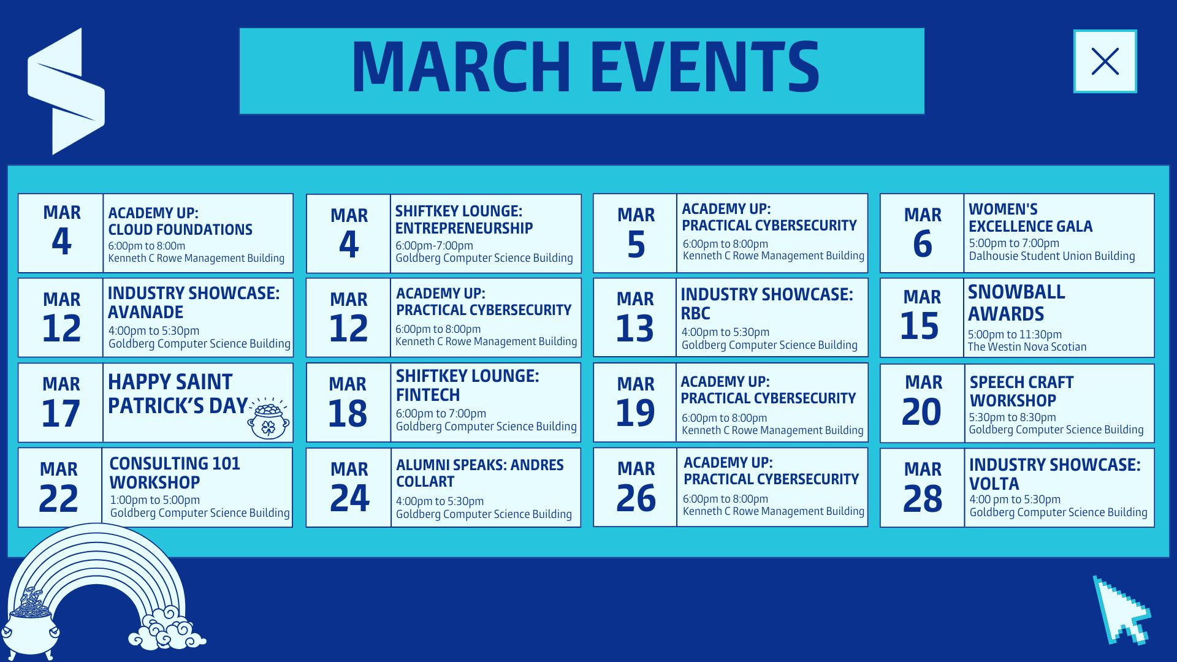

Slide 2


Slide 3

Practical Cybersecurity
Instructor – Aman Bhalla

Slide 4
Week 3 Learning Objectives
Understand OWASP & Web Application Security
Learn about OWASP Top 10 threats and how they impact applications.
Discover how the OWASP list is maintained and updated.
Explore Advanced Cyber Threats
Understand zero-day exploits, supply chain attacks, and injection vulnerabilities.
Learn real-world examples of application security failures.
Dive Deep into Incident Response
Explore the 6 phases of incident response and how organizations handle cyberattacks.
Engage in a Hands-On Threat Hunting Activity
Identify Indicators of Compromise (IoCs) and map attack tactics.

Slide 5
What is Application Security?
Definition: Application security refers to practices that prevent security vulnerabilities in software applications.
Why is it Important?
80% of cyberattacks target web applications.
Attackers exploit flaws in code to steal data, hijack accounts, or inject malicious scripts.
Proactive security is cheaper and more effective than fixing security breaches later.
Example: The Equifax data breach (2017) exposed 147M customer records due to an unpatched software vulnerability in a web application.

Slide 6
Introduction to OWASP
What is OWASP?
The Open Worldwide Application Security Project (OWASP) is a nonprofit focused on improving software security.
Provides open-source tools, frameworks, and security best practices.
Maintains the OWASP Top 10 – a list of the most critical web application security risks.
Why does this matter? Many compliance standards, like PCI-DSS and NIST, reference OWASP guidelines.

Slide 7
How is OWASP Top 10 Updated?
OWASP Top 10 is updated every 3-4 years based on:
Global data collection from security research.
Threat intelligence reports & vulnerability trends.
Ranking based on exploitability & impact.
Latest update: The 2021 OWASP Top 10 introduced new categories like Insecure Design and SSRF.

Slide 8


OWASP Top 10 Threats (2021)
Most critical web application vulnerabilities:
Broken Access Control
Cryptographic Failures
Injection Attacks
Insecure Design
Security Misconfiguration
Vulnerable & Outdated Components
Identification & Authentication Failures
Software & Data Integrity Failures
Security Logging & Monitoring Failures
Server-Side Request Forgery (SSRF)

Slide 9

Broken Access Control
Definition: Attackers bypass permissions to access restricted data or functionalities.
Example: A normal user modifies a URL to access an admin-only page.
Mitigation: Enforce role-based access control (RBAC) and strict session management.

Slide 10
Cryptographic Failures
Definition: Weak encryption or missing encryption leads to data breaches.
Example: Websites storing passwords in plaintext instead of hashing them.
Mitigation: Use AES-256, TLS 1.3, and bcrypt for passwords.

Slide 11
Injection Attacks (SQL, Command, LDAP, NoSQL Injection)
Definition: Attackers inject malicious code into user inputs, exploiting weak database or command handling.
Example: OR 1=1 -- in a login field bypasses authentication.
Mitigation: Use prepared statements and sanitize all inputs.

Slide 12
Insecure Design
Definition: Applications designed without security in mind, allowing for easy exploitation.
Example: An e-commerce site allowing unlimited failed login attempts without a lockout policy.
Mitigation: Conduct threat modelling and secure application design reviews.

Slide 13
Security Misconfiguration
Definition: Applications left with default settings, exposed files, or unnecessary features enabled.
Example: A server left with an open directory listing, exposing sensitive files.
Mitigation: Regular configuration audits and principle of least privilege implementation.

Slide 14
Vulnerable & Outdated Components
Definition: Using outdated or vulnerable software libraries and frameworks.
Example: The Log4j vulnerability (2021) allowed attackers to execute remote code.
Mitigation: Implement automated dependency tracking and apply patches regularly.

Slide 15
Identification & Authentication Failures
Definition: Weak authentication mechanisms allow unauthorized access.
Example: Allowing brute force attacks without account lockout mechanisms.
Mitigation: Enforce Multi-Factor Authentication (MFA) and strong password policies.

Slide 16
Software & Data Integrity Failures
Definition: Unverified software updates and insecure serialization leading to code execution attacks.
Example: A malicious actor injects code into a software update, compromising all users.
Mitigation: Use signed updates and integrity checks for all external components.

Slide 17
Security Logging & Monitoring Failures
Definition: Lack of effective logging allows attacks to go undetected.
Example: A hacker attempts 1000 failed logins, but no alerts are triggered.
Mitigation: Implement real-time security monitoring and log correlation for early detection.

Slide 18
Server-Side Request Forgery (SSRF)
Definition: Attackers trick a web server into making unauthorized internal requests.
Example: A cloud-based web app retrieves external files but allows unrestricted internal access, letting an attacker extract data.
Mitigation: Restrict remote network calls and validate URLs before processing requests.

Slide 19
What is Incident Response?
Incident response (IR) is a structured approach organizations use to identify, manage, and recover from cybersecurity incidents. A well-defined Incident Response Plan (IRP) helps minimize damage, reduce recovery time, and prevent future attacks.
Why is Incident Response Important?
Reduces downtime & financial losses from cyberattacks.
Minimizes data breaches by containing threats quickly.
Ensures compliance with industry security regulations (e.g., GDPR, NIST).

Slide 20
The 6 Phases of Incident Response
The Incident Response Plan (IRP) includes:
Preparation – Establish security policies & train employees.
Detection & Analysis – Identify security breaches.
Containment - Limit the damage.
Eradication – Remove threats.
Recovery – Restore systems to normal.
Post-Incident Analysis – Learn from the attack & improve security.

Slide 21
Preparation
Goal: Ensure the organization is ready to handle incidents effectively.
Establish security policies & protocols.
Train employees on cybersecurity best practices (phishing awareness, social engineering).
Set up logging & monitoring tools to detect threats early.
Define incident severity levels (low, medium, high, critical).
Conduct Tabletop Exercises (TTX) – Simulated cyberattack drills.

Slide 22
Detection & Analysis
Goal: Identify the attack, assess its scope, and determine the impact.
Use Intrusion Detection/Prevention Systems (IDS/IPS) to spot unusual activity.
Analyze firewall logs, system alerts, and network traffic for anomalies.
Identify Indicators of Compromise (IoCs) (e.g., unusual login attempts, data exfiltration).
Categorize the attack: Malware, Phishing, Ransomware, DDoS, Insider Threat, etc.
Example: A DDoS attack floods a company’s website, causing slowdowns—security logs reveal thousands of fake requests from a single region.

Slide 23
Containment
Goal: Isolate & limit the impact of the attack.
Short-term containment: Disconnect affected systems from the network.
Long-term containment: Apply security patches, strengthen authentication.
Quarantine infected files to prevent malware from spreading.
Implement temporary firewall rules to block further attacks.
Example: A ransomware attack encrypts company files—security teams immediately disconnect infected systems to stop the spread.

Slide 24
Eradication
Goal: Remove the threat completely from the environment.
Delete malware files, malicious accounts, and backdoors.
Apply security patches & software updates to fix vulnerabilities.
Strengthen endpoint security to prevent reinfection.
Use threat intelligence reports to understand the attacker’s tactics.
Example: After removing a trojan virus, security teams discover it entered via an unpatched software vulnerability—they immediately apply the missing patch.

Slide 25
Recovery
Goal: Restore affected systems & resume normal operations securely.
Restore data from clean backups (ensure backups weren’t compromised).
Monitor for signs of reinfection before reconnecting systems.
Conduct post-incident vulnerability assessments.
Strengthen network defenses (firewalls, MFA, encryption).
Example: After a data breach, an organization resets all employee passwords and enforces Multi-Factor Authentication (MFA) for added security.

Slide 26
Post-Incident Review
Goal: Analyze the attack, improve defenses, and prevent recurrence.
Conduct a post-mortem analysis – What happened? What went wrong?
Update the Incident Response Plan (IRP) based on findings.
Implement security awareness training for employees.

Slide 27

Case Study – Uber Data Breach (2022)
What Happened?
Hacker used social engineering to access Uber’s internal systems.
MFA Bypass Attack tricked employees into granting access.
Incident Response Actions:
Uber revoked compromised credentials and locked down access.
Implemented stricter MFA policies and enhanced security awareness.
Conclusion: Employee awareness is critical – even advanced security can fail to social engineering.

Slide 28

Key Takeaways
OWASP Top 10 is critical – Web applications are prime attack targets.
Incident Response must be structured – A well-defined process minimizes damage.
Cyber Threat Intelligence helps organizations stay ahead of attacks.
Threat Hunting is an advanced cybersecurity skill used in real-world SOCs.

Slide 29
Next Week Preview
Introduction to Penetration Testing
Exploring Ethical Hacking Concepts.
Cyber Laws & Ethics – Understanding legal aspects of hacking.
Final Exam Overview – What to expect & key topics to review.

Slide 30

Q&A

Slide 31

Quiz Time!
Time Limit – 15 Minutes. Quiz begins at 7:45 pm and will close at 8:00 pm.
Questions: MCQs, True or False and Short Answers.
Some questions require multiple choices, only choosing all the correct ones will get points.

